Slide 1
Conducting a Respiratory Assessment on a Spontaneously Breathing Patient

Slide 2
You may be asked to conduct a full respiratory assessment on a spontaneously breathing patient in the following situations:
In ER.
Getting called by a wards RN to see a patient the RN is worried about.
Post extubation.
Assist anesthesiologist in conducting an airway assessment prior OR.
So how do you do it?

Slide 3
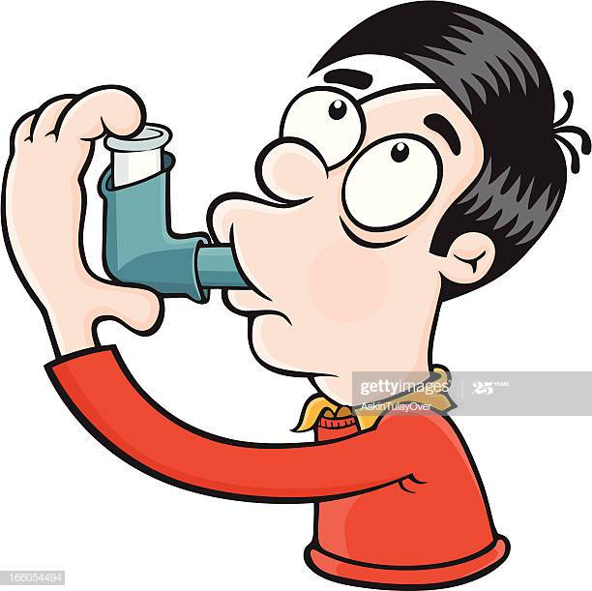
CASE 1
You are in ER and the triage RN calls you with the following:
Mr. Trudell is a 47 year old who came to ER after 3 days of feeling SOB, sounds wheezy and says he has a dry cough and feels like coffee helps him feel slightly less SOB. His family doctor prescribed ventolin but the SOB is getting worse.
PMH: childhood asthma, pollen allergy,
previous concussion.
What will you assess?

Slide 4
General Assessment Rules
As you approach the patient, assess what the patient looks like overall: comfortable? calm? eating? drinking? talking? Distressed?
Introduce self to patient, assess and ask:
Assess level of consciousness
How would you describe your SOB?
What causes you to feel SOB?
What improves your SOB?
Cough and sputum production
  time of max sputum production “when do you cough up the most”
  min sputum production “when do you cough up the least”
  Ask the patient to cough and assess quality of cough: strong, moderate, weak, productive? non productive?

Slide 5
General Assessment Rules
Use inspection to identify the following:
  Patient position:
        supine, semi-fowlers, fowlers?
  RR and Breathing Pattern:
        slow and deep, fast and shallow, do they cough on deep inhalation? Apneas?
  Are they able to lay flat?
  WOB
  Cyanosis? clubbing? diaphoresis? edema?
  Ability to speak in full sentences? How many words per sentence?

Slide 6
General Assessment Rules
Chest assessment:
  Auscultate breath sounds
        Is air entry equal? Adventitious sounds? Biphasic?
  Chest shape abnormalities?
  Chest wall movement:
        accessory muscle use, paradoxical abdominal breathing?

Slide 7
Patient received in Fowler’s position. Awake, alert and appropriate. On 2lpm NP, SpO2= 94%, RR= 24bpm, BP= 127/84 mmHg, Temp= 37.4. Patient is able to speak in 4 word sentences, has nasal flaring and states that he feels SOB. O/A bilat equl A/E T/O, Br/S exp. Wheezes T/O. Patient has a moderate spontaneous non-productive cough and states that he is not producing sputum. Gave 5mg Ventolin and 5 mcg Atrovent neb x 3. Post bronchodilators Br/S clear and patient states that he feels less SOB. Nasal flaring resolved. O/A………..Vitals………………..
Plan:……………………….

Slide 8
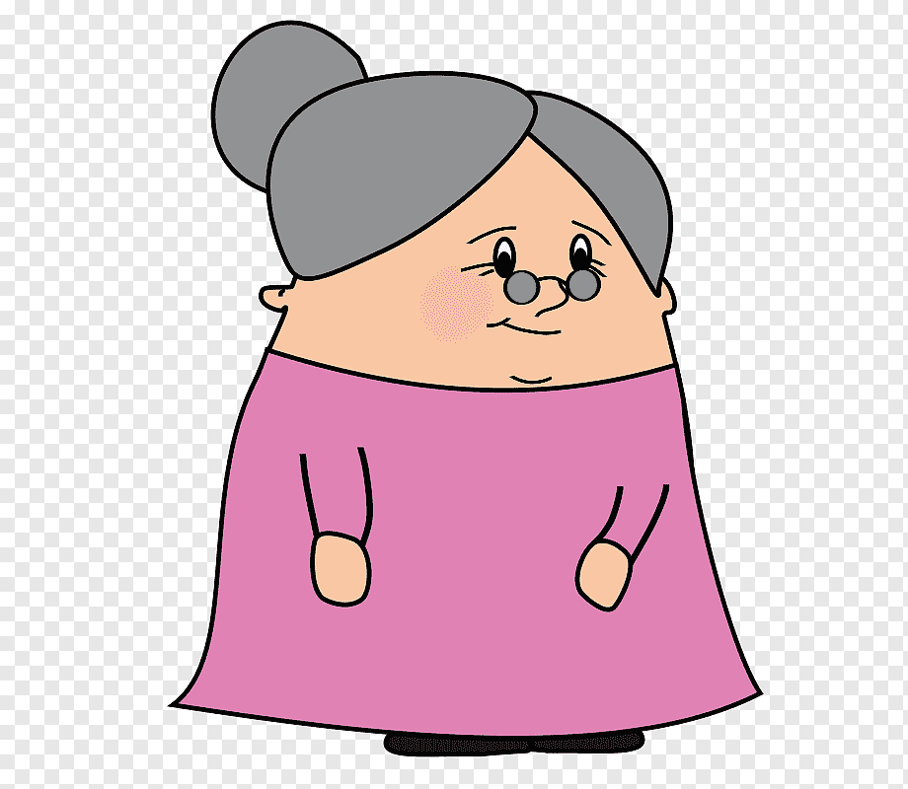
CASE 2:
Mrs Keller is a 67 year old female. She comes to ER with increased tiredness, feeling “puffy”, unable to sleep through the night and finds that she sleeps better in her rocking chair.
PMH: obesety, anxiety, chronic back pain post
MVA 20 years ago.
What do you think is going on?

Slide 9
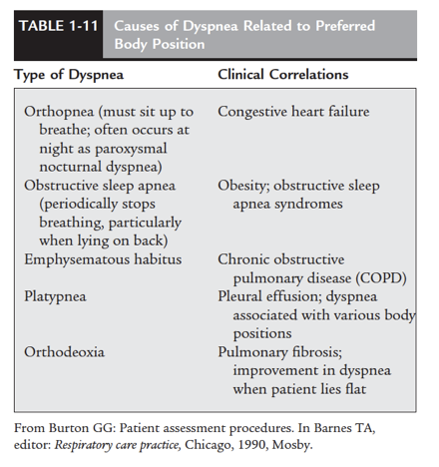
Dyspneas

Slide 10
Evaluation of Orthopnea
The following are examples of questions to ask in evaluating orthopnea:
1. “Do you wake up at night with SOB?”
2. “Does your nighttime SOB get better after you sit up on the side of your bed or in a chair?”
3. “Do you get SOB when lying down to take a nap?”
4. “Do you use extra pillows behind your head and back to help you not get SOB at night or during a nap?”
5. “How many pillows do you need to keep you from getting SOB at night or when taking a nap?”

Slide 11
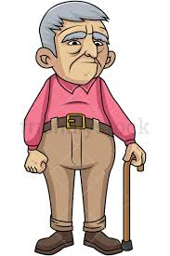
CASE 3
Mr. Jingle is a 73 year old male. He was referred to you at the BC Cancer Agency because he is experiencing SOB.
PMH: laryngeal cancer requiring radiation- now healthy, previous broken femur, depression, ex- smoker of 50 years
The doctor asks you to perform a Home Oxygen assessment
for the patient’s dyspnea. But the patient does not qualify.
What could be the source of his SOB? How will you ask
questions?

Slide 12
Evaluating Dyspnea
The following are examples of questions to ask in evaluating dyspnea:
“How far can you walk before you feel short of breath?”
“How many flights of stairs can you climb before you experience SOB?”
“How far can you walk when walking as fast as your spouse?”
“Is there anything you do that makes the SOB worse?”
“Is there anything you do that makes the SOB better?”
“How long does the SOB last after you stop to rest?”
“Is the SOB worse at any particular time of the day?”
“Is the SOB worse at any particular time of the year?”

Slide 13
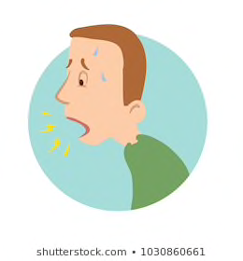
Causes of Breathlessness
Infection /pneumonia, deconditioning, anemia, cachexia, hypoxia, Surgery causes pain, reduced ventilatory capacity, reserve, and diffusion. Chemotherapy can cause: CHF, pericardial effusion, endocardial fibrosis, myocardial ischemia, lung fibrosis. Radiation can cause pericardial effusion/constriction, thickening of pericardium, lung fibrosis. Smoking (current or history of). Anxiety, fear surrounding illness, depression.
Lung co-morbidities affecting:
Hyperinflation (COPD, asthma)
Deadspace (COPD, pulmonary valvular disorders)
lung compliance (fibrosis following P.E., Chemo, Radiation, drugs)
tumor blocking airways,
pleural effusions, pleural disease
Compliance of chest wall/diaphragm,(ascities, hepatomegaly, chest wall tumor, obesity)
pulmonary congestion, (PE, heart fail, pericardial effusion, Pulm HTN, ILD)

