Slide 1
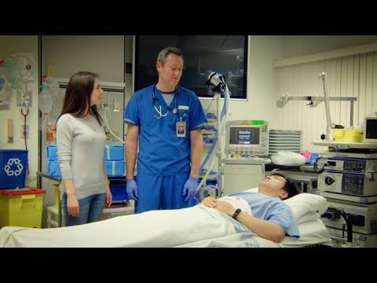
Notes:
https://youtu.be/t8YWz8o5HYQ

Slide 2
Assessment
of
Breathlessness

Slide 3
On your mobile device please go to:
KAHOOT.IT

Slide 4
When would you need to perform a breathlessness assessment?

Slide 5
Prior to surgery
Wards
After removing the patient’s breathing tube
Emergency Department
So how do you do it?

Slide 6

CASE 1
You are in the emergency department and the nurse calls you with the following:
Mr. Trudell is a 47 year old who came to emerg after 3 days of feeling SOB, sounds wheezy and says he has a dry cough and feels like coffee helps him feel slightly less SOB. His family doctor prescribed ventolin but the SOB is getting worse.
Past Medical History: childhood asthma, pollen allergy.
What will you assess?

Slide 7
General Assessment Rules
Assess level of consciousness
How would you describe your SOB?
What causes you to feel SOB?
What improves your SOB?
Cough and sputum production
  time of max sputum production “when do you cough up the most”
  min sputum production “when do you cough up the least”

Slide 8
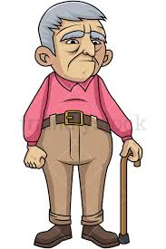
CASE 2
Mr. Jingle is a 73 year old male. He was referred to you at the BC Cancer Agency because he is experiencing SOB.
PMH: laryngeal cancer requiring radiation- now healthy, previous broken femur, depression, ex- smoker of 50 years
The doctor asks you to conduct a respiratory assessment.
What could be the source of his SOB? How will you ask
questions?

Slide 9
Evaluating Shortness of Breath
The following are examples of questions to ask in evaluating SOB:
“How far can you walk before you feel short of breath?”
“How many flights of stairs can you climb before you experience SOB?”
“How far can you walk when walking as fast as your spouse?”
“Is there anything you do that makes the SOB worse?”
“Is there anything you do that makes the SOB better?”
“How long does the SOB last after you stop to rest?”
“Is the SOB worse at any particular time of the day?”
“Is the SOB worse at any particular time of the year?”

Slide 10
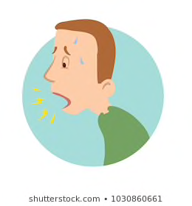
Causes of Breathlessness
Deconditioning
Anemia
Cachexia
Hypoxia
Chemotherapy can cause: CHF, pericardial effusion, endocardial fibrosis, myocardial ischemia, lung fibrosis.
Radiation can cause pericardial effusion/constriction, thickening of pericardium, lung fibrosis.
Smoking (current or history of)
Anxiety, fear surrounding illness, depression.

Slide 11
Lung Sources
Hyperinflation (COPD, asthma)
Deadspace (COPD, pulmonary valvular disorders)
Lung compliance (fibrosis following P.E., Chemo, Radiation, drugs)
Tumor blocking airways
pleural effusions, pleural disease
Compliance of chest wall/diaphragm,(ascities, hepatomegaly, chest wall tumor, obesity)
Pulmonary congestion, (PE, heart fail, pericardial effusion, Pulm HTN, ILD)

Slide 12
IN THE MESSAGE BOX, PLEASE TYPE:
ONE STRENGTH
ONE AREA FOR IMPROVEMENT

